Slide 1
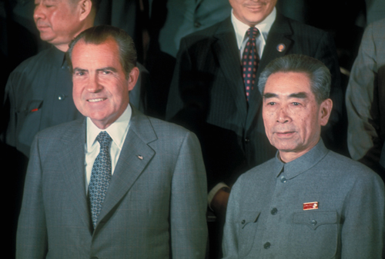
Nixon's Foreign Policy

Slide 2
Terms and People
Henry Kissinger − President Nixon’s leading adviser on national security and international affairs
realpolitik − the belief that political goals should be defined by concrete national interests instead of abstract ideologies
Zhou Enlai − Premier of China when Nixon made a state visit to China in 1972

Slide 3
Terms and People (continued)
Strategic Arms Limitation Treaty (SALT I) − 1972 treaty between the United States and the Soviet Union that froze the deployment of intercontinental ballistic missiles and placed limits on antiballistic missiles
détente − flexible diplomacy adopted by Richard Nixon to ease tensions between the United States, the Soviet Union, and the People’s Republic of China

Slide 4
President Nixon redefined U.S. foreign policy.
He did not divide the world into “us” (democratic countries) and “them” (communist countries).
He practiced realpolitik — foreign policy based on concrete national interests rather than ideology.

Slide 5
Improve the country’s relations with China and the Soviet Union.
Henry Kissinger was President’s Nixon’s leading adviser on national security and international affairs.

Slide 6
Diplomatic relations with China would bring economic opportunities to the United States.
An improved relationship with China would weaken China’s ties to the Soviet Union.
A political realist, Nixon wanted to establish diplomatic relations with China.
The United States stood to gain much by recognizing China.

Slide 7
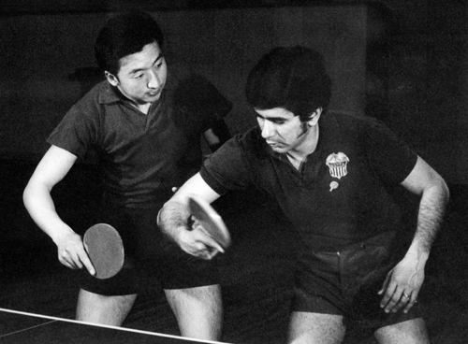
China invited an American ping-pong team to play in a tournament.
Kissinger used that opportunity to work behind the scenes, talking with Chinese leaders and ironing out sensitive issues.
Chinese and American players training together

Slide 8
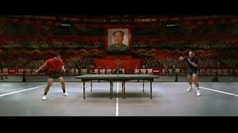
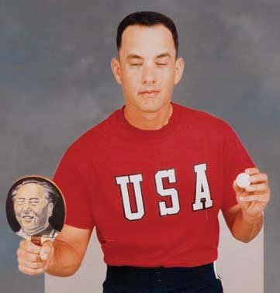
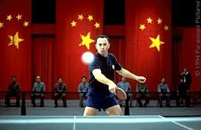

Slide 9
In February 1972, President Nixon visited China and met with Chinese

Slide 10
Nixon’s visit to China resulted in several benefits for the United States.
Trade thrived between the United States and China.
American tourists began to visit China.
Soviet leader Leonid Brezhnev invited President Nixon to visit Moscow.

Slide 11
In May 1972, Nixon met with Brezhnev in Moscow.
They signed SALT 1, the Strategic Arms Limitation Treaty, a major step towards ending the nuclear arms race.
The two leaders agreed to reduce pollution and undertake a joint U.S.–Soviet space mission.

Slide 12
Nixon’s policy of détente, the easing of Cold War tensions, replaced the old policy based on suspicions and distrust.
His foreign-policy breakthroughs moved the world closer to the end of the Cold War.

